Slide 1
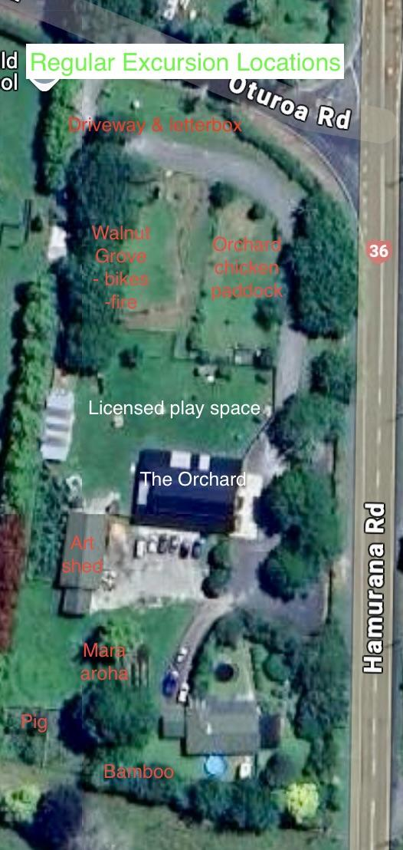
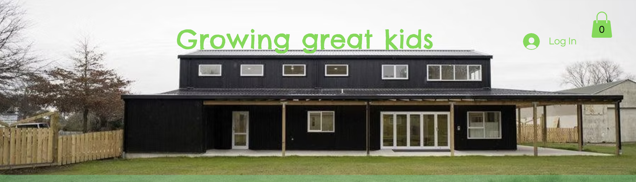
The Orchard
Child Care & Preschool
Hamurana, Rotorua, New Zealand

Slide 2
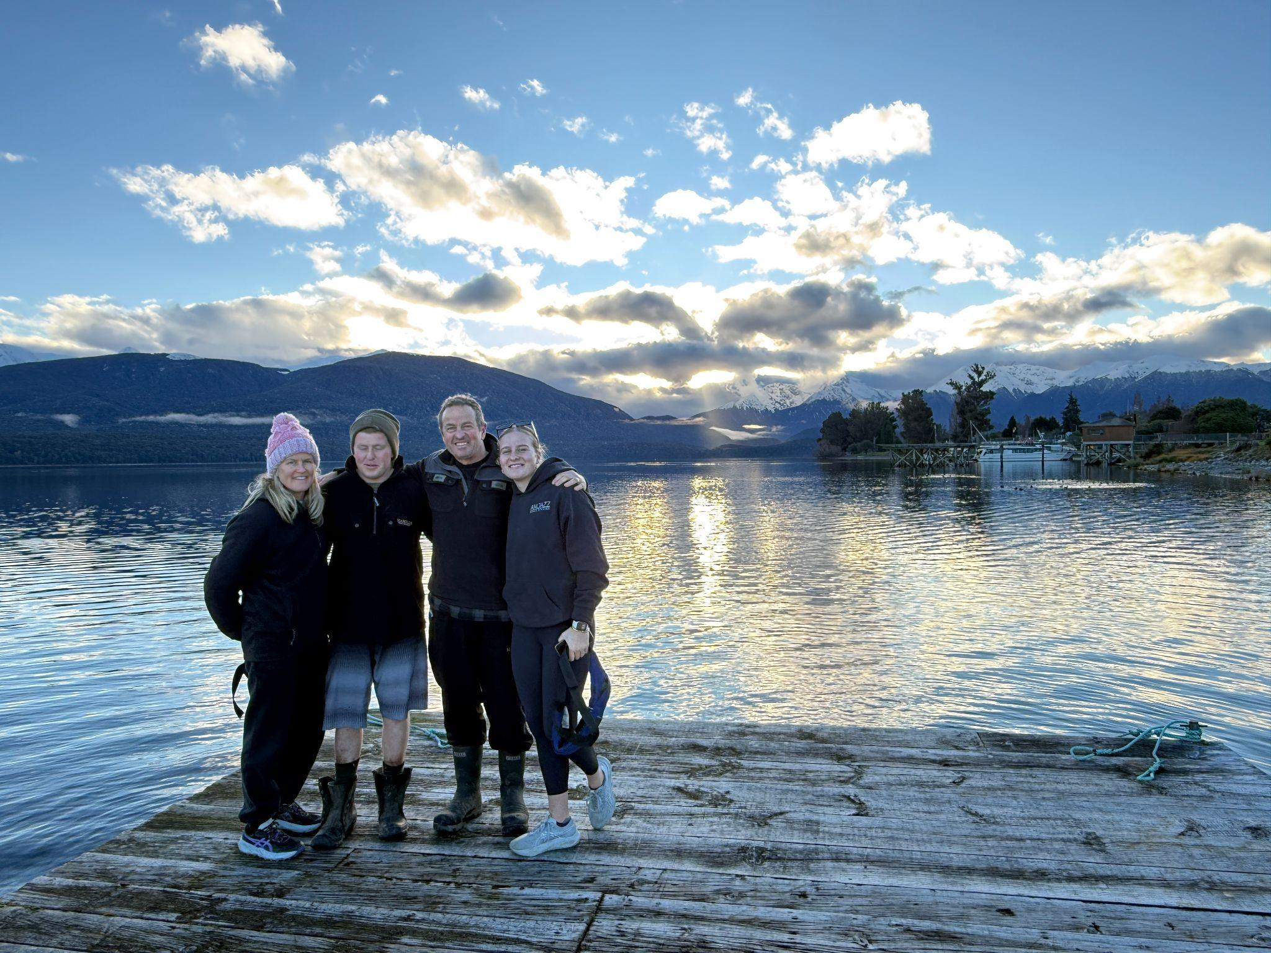
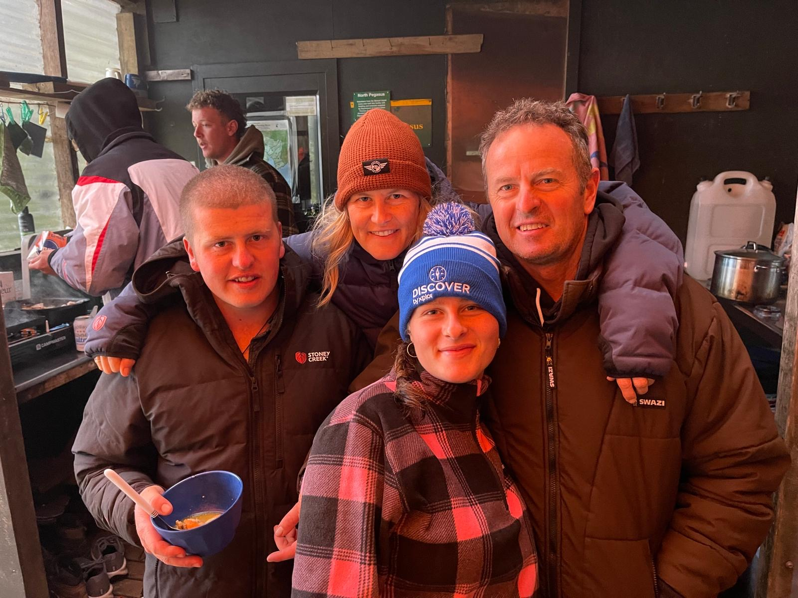
Me
July 2026
Te Anau
Rotorua (Studied Waikato Uni, travelled OE England, Europe)
Former primary school teacher(1999-2013)
Managed family manufacturing business (2002/2004)
ECE since 2013
Love exploring, running, travel (incl seeing ECEs abroad), LOVE NZ natural environment… hence eco ECE
Work 4 days: Mon teacher, Tue Admin, Wed & Thu Admin or relief cover.
Why am I here at ECC conf??
Stewart Island, Jan 2026
Celebrating Luke’s 18th

Slide 3
2025 ECC Conference Centre Tour Stop

Slide 4
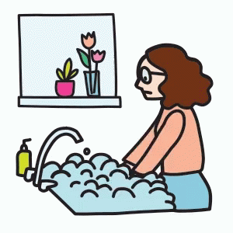
Bit of Background
Commit your works to the Lord and your plans will be established
Proverbs 16:3
Est 2013… Lots of prayers and disappointments
Christian based
Nature loving
2 acres of land - amazing but hard work
50 children a day
10 “under two” babies and toddlers
100% Fully qualified staff, Full pay parity… more on this later

Slide 5
Video removed for privacy

Slide 6
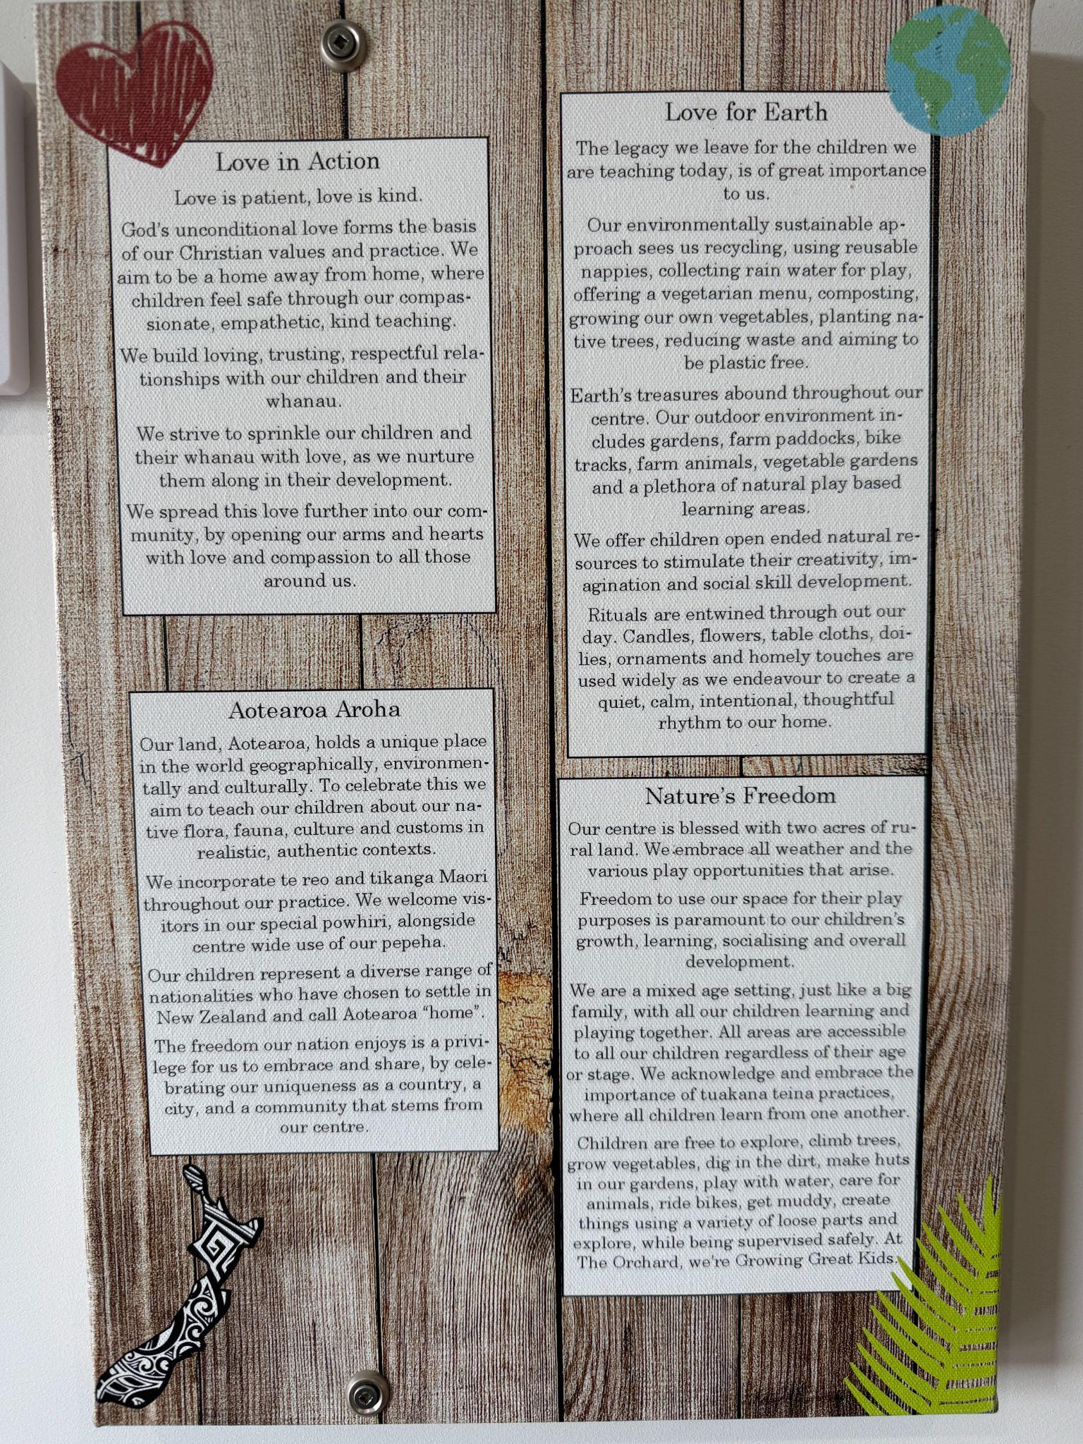
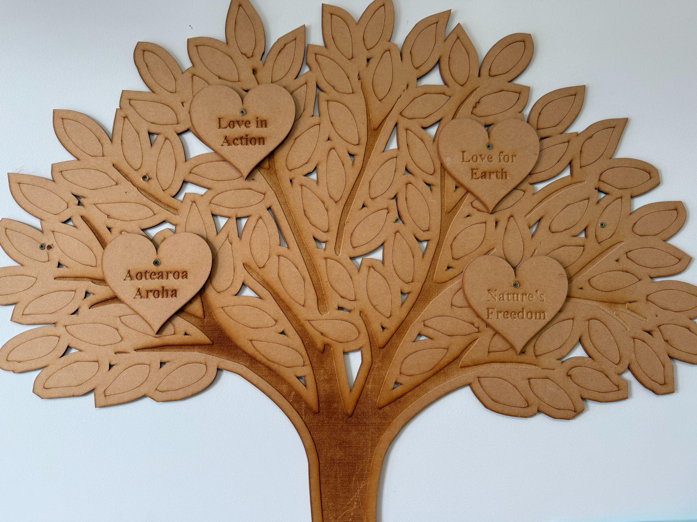

Slide 7
Our Philosophy
Love for Earth
The legacy we leave for the children we are
teaching today, is of great importance to us.
Our environmentally sustainable approach
sees us recycling, using reusable nappies, col-
lecting rain water for play, offering a vegetar-
ian menu, composting, growing our own vege-
tables, planting native trees, reducing waste
and aiming to be plastic free.
Earth’s treasures abound throughout our cen-
tre. Our outdoor environment includes gar-
dens, farm paddocks, bike tracks, farm ani-
mals, vegetable gardens and a plethora of
natural play based learning areas.
We offer children open ended natural re-
sources to stimulate their creativity, imagina-
tion and social skill development.
Rituals are entwined through out our day.
Candles, flowers, table cloths, doilies, orna-
ments and homely touches are used widely as
we endeavour to create a quiet, calm, inten-
tional, thoughtful rhythm to our home.
Love in Action
Love is patient, love is kind.
God’s unconditional love forms the basis of our Christian values and practice. We aim to be a home away from home, where children feel safe through our compassionate, empathetic, kind
teaching.
We build loving, trusting, respectful relationships with our children and their whanau.
We strive to sprinkle our children and their
whanau with love, as we nurture them along in their development.
We spread this love further into our community, by opening our arms and hearts with love and compassion to all those around us.

Slide 8
Nature’s Freedom
Our centre is blessed with two acres of rural
land. We embrace all weather and the vari-
ous play opportunities that arise.
Freedom to use our space for their play pur-
poses is paramount to our children’s growth,
learning, socialising and overall develop-
ment.
We are a mixed age setting, just like a big
family, with all our children learning and
playing together. All areas are accessible to
all our children regardless of their age or
stage. We acknowledge and embrace the im-
portance of tuakana teina practices, where
all children learn from one another.
Children are free to explore, climb trees,
grow vegetables, dig in the dirt, make huts in
our gardens, play with water, care for ani-
mals, ride bikes, get muddy, create things us-
ing a variety of loose parts and explore, while
being supervised safely. At The Orchard,
we’re Growing Great Kids.
Aotearoa Aroha
Our land, Aotearoa, holds a unique place in the
world geographically, environmentally and cul-
turally. To celebrate this we aim to teach our
children about our native flora, fauna, culture
and customs in realistic, authentic contexts.
We incorporate te reo and tikanga Maori
throughout our practice. We welcome visitors in
our special powhiri, alongside centre wide use of
our pepeha.
Our children represent a diverse range of na-
tionalities who have chosen to settle in New
Zealand and call Aotearoa “home”.
The freedom our nation enjoys is a privilege for
us to embrace and share, by celebrating our
uniqueness as a country, a city, and a communi-
ty that stems from our centre.

Slide 9
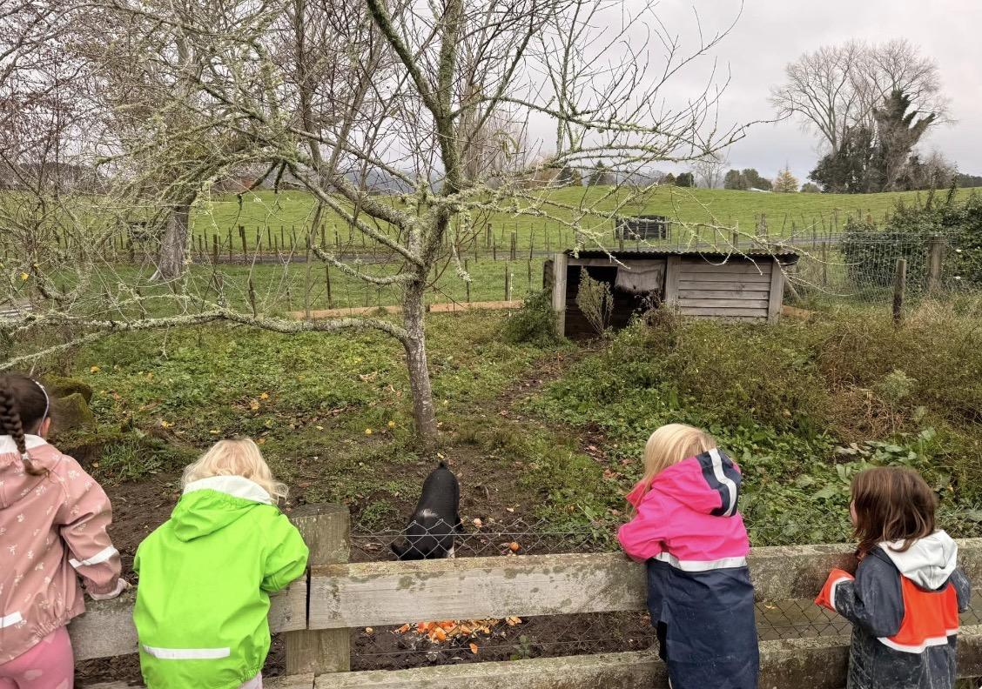

Slide 10
Our Environmental Practice
Environmental Practice Statement
In keeping with our philosophy around caring for God’s creation and in conjunction with Te Whariki (our NZ ECE curriculum), we acknowledge the role we have in guiding the future kaitiaki of our planet. The Māori world view (te ao Māori) acknowledges the interconnectedness and interrelationship of all living & non-living things, which we strive to teach our tamariki.
“Love for Earth”
The legacy we leave for the children we are teaching today, is of great importance to us.
We have adopted the following practices, to make our impact on our earth slightly softer.
Kitchen
· Buy ingredients in bulk and use concentrated cleaning products to avoid excessive packaging
· Purchase in glass or aluminium packaging, that is easily recyclable
· Recycle all materials that are recyclable
· Food scraps and waste is fed to onsite animals (pig, chickens)
· Reusable crockery and cutlery is used at all meals
· Whanau bring reusable crockery and utensils to whanau events to eliminate disposable plates, etc

Slide 11
-Our menu is vegetarian to reduce our carbon footprint in production of red meat, overfishing of fish stocks and condensed hen raising methods.
· Reusable hand towels are used at dining handwash area
· We use cotton dishcloths that are compostable at end of lifespan
· Soft plastics are collected from centre and families and recycled at local Woolworth stores
· Batteries are collected from centre and families and sent to recycling agent once bucket is full
Bathroom
· Taps are pressurised to turn off to conserve water use
· Paper towels are used in bathroom area, these are burned to reduce landfill or used as compost
Reusable face clothes used at dining area to wipe faces and dry for after hand washing.
· Bleach spray is made from concentrated bleach to clean all areas, avoiding excessive packaging.
Care Moments
· We use reusable nappies and wipes to lessen the use of fossil fuels used in production of disposable nappies and to reduce landfill waste of a product with an unknown decomposition time or impact
· We use paper towels for clean up of nappy change area between children
· Compostable, biodegradable bamboo wipes are used when wipes are necessary.

Slide 12
Laundry
· Packaging is recycled once used
· Cleaning products purchased in bulk in concentrated form where possible
· Reusable, washable mop heads are used
· Eco washing cycle is used (excl nappies)
· Buckets for soaking are reused
Office
· Notices and invoices are sent digitally to avoid use of paper
· Payments only made and accepted using internet banking to lessen environmental impact of trip to bank.
· Paper waste is shredded and recycled
· Paper is reused where appropriate
Outside
· Mara aroha – our giving garden. We aim to grow many of the vegetables and share excess with our local community, to reduce carbon footprint of food being grown elsewhere and transported and potentially grown using excessive fertilisers.
· Many of our resources that the children use are natures treasures, that teachers have foraged for or whanau bring in.
· Resources upcycled from whanau or second hand stores, to reduce consumer driven economy
· Aim to grow from seed in green house, plants that are grown in our Mara Aroha garden’
·

Slide 13
- Native garden growing and extended to encourage local fauna and absorb some of our carbon emissions
· Loose parts play using upcycled materials and extending children’s imaginative play
· Outside play is encouraged in all weather to deepen our children’s understanding of their environment and the way it changes with the weather
· Rain water is collected and used for play.
Play resources
· Single use resources are avoided to lessen waste and decrease manufacture of goods using precious fossil fuels
· Glitter is never used, as it’s production uses precious resources and the product is a micro plastic that enters our environment
· Natural resources are provided
· Where plastic resources are provided, they are of high quality for long term, sustainable play – eg mobilo.
We are always looking for ways to extend or develop our practice in caring for our earth. Please make any suggestions you feel we could adopt.

Slide 14
Our Localised Curriculum
Throughout the children’s time at The Orchard, they will experience a healthy environment where through our sustainable practices, we encourage healthy lifestyles with gardening, food, active exploration and working towards independent self care.
(WELLBEING) 1/20
Throughout the children’s time at The Orchard, they will experience an accepting environment where emotions are expressed, acknowledged and supported through manaakitanga and our love in action. We understand that every day is different and that our children’s wairua can differ, based on their needs.
(WELLBEING) 2/20
Our Orchard Whariki
Learning outcomes rewritten to show our place and what’s important to us and our whanau

Slide 15
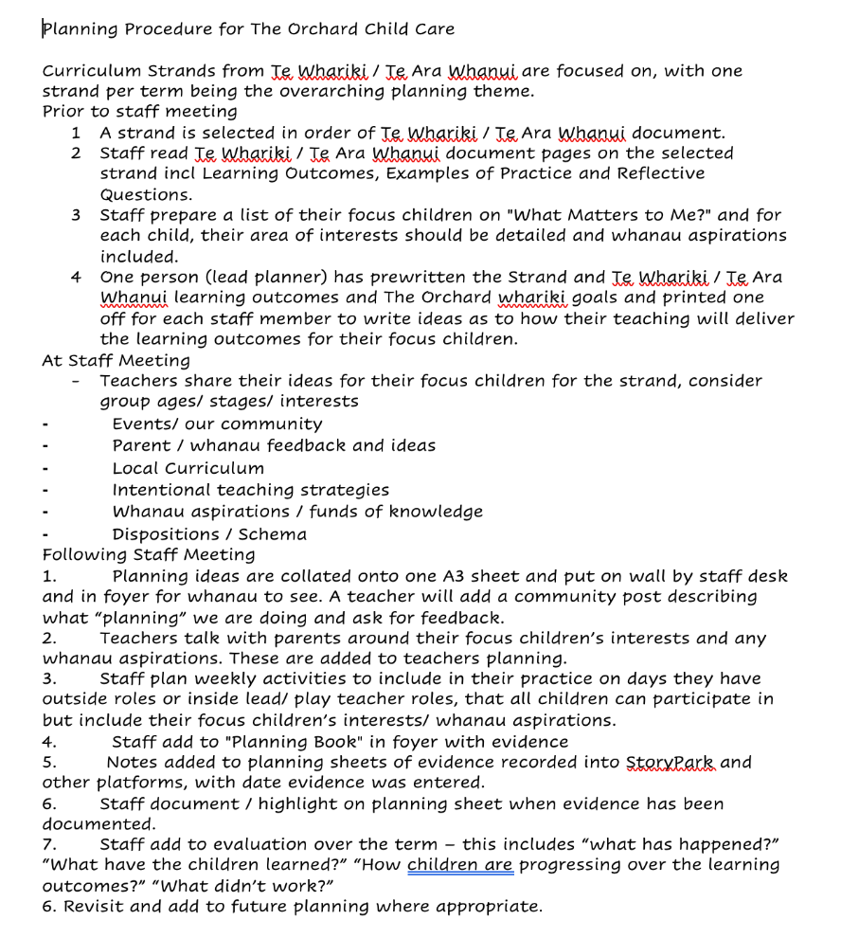
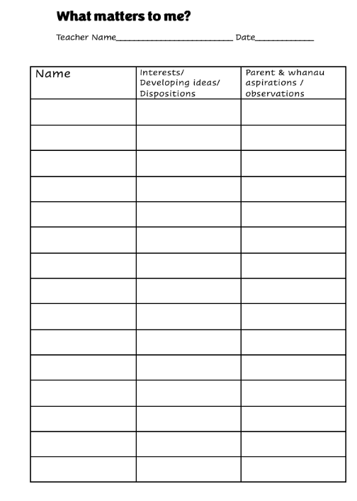

Slide 16
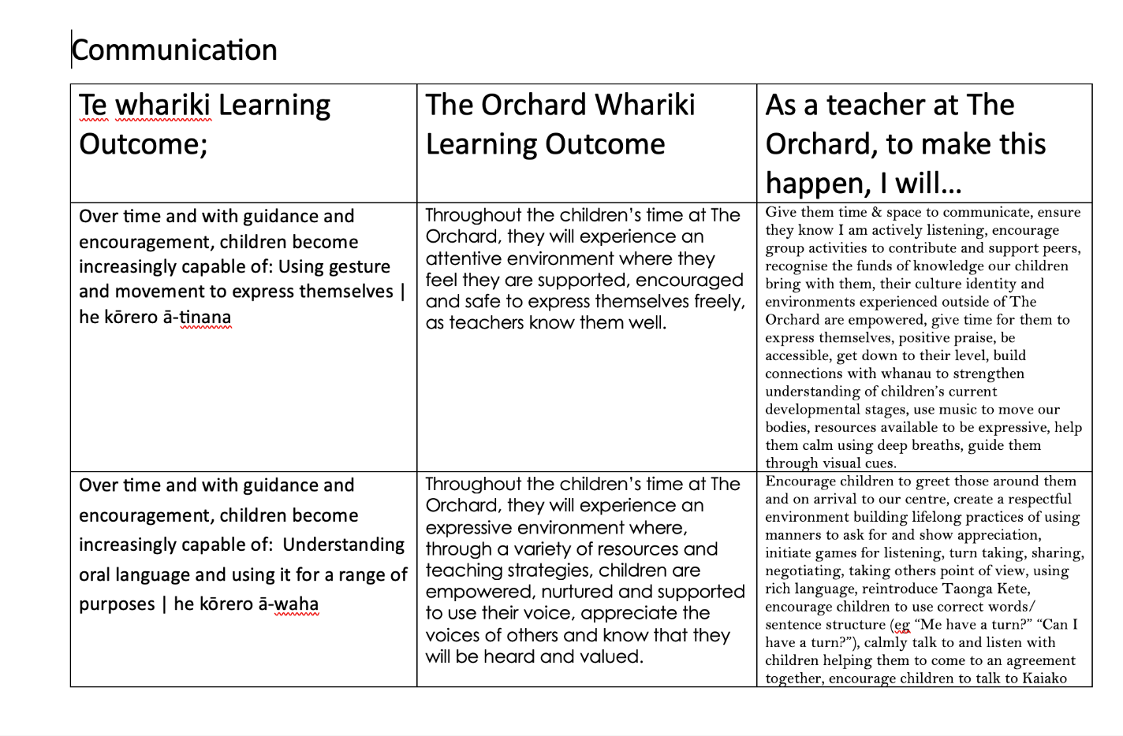

Slide 17
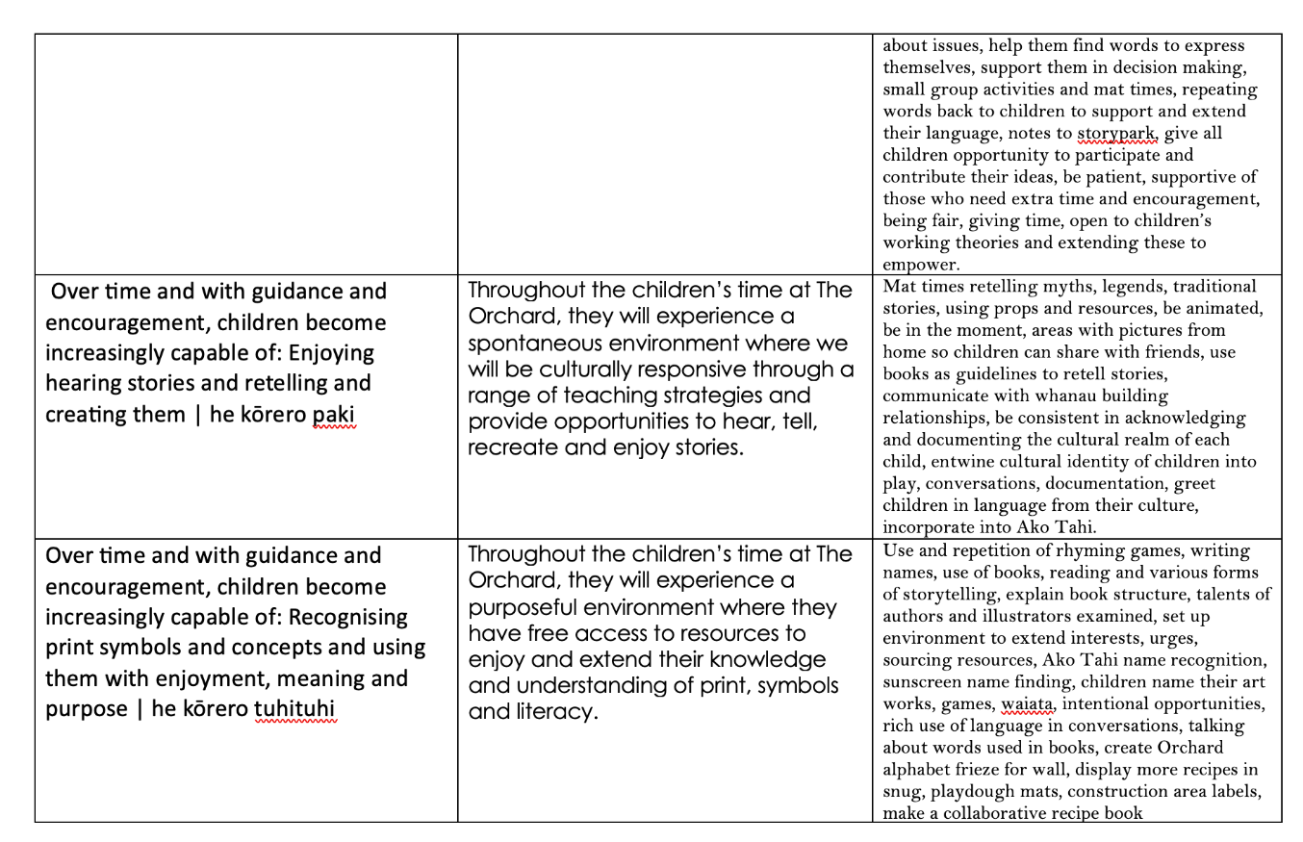

Slide 18
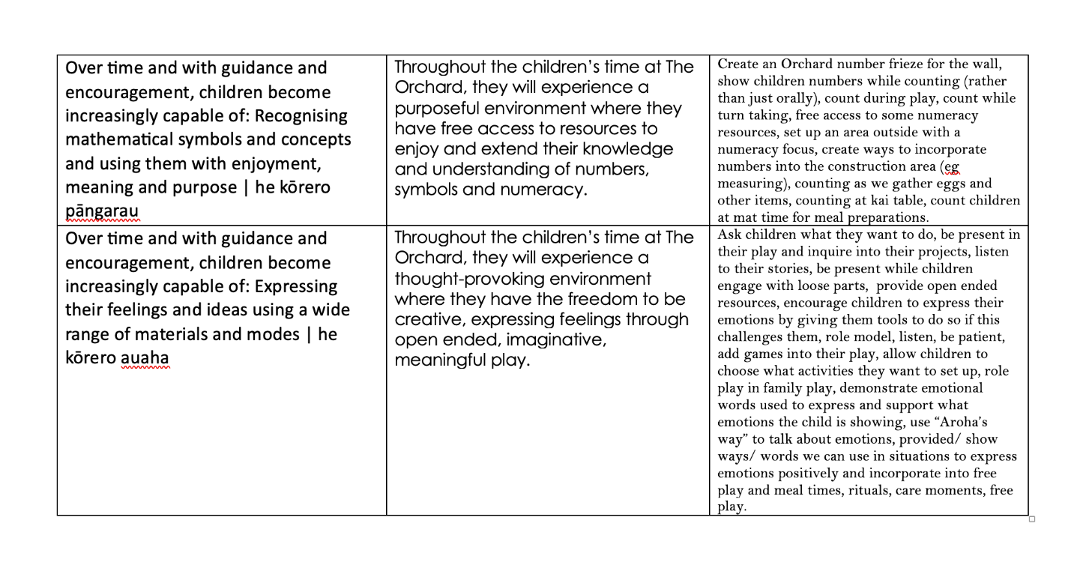

Slide 19
So… let’s talk about fun… and compliance 🤨…

Slide 20
You will need a robust excursion policy for regular excursions.
Here’s one of ours - we have 4 for the various areas around our centre…
Thanks to 🐓 for getting MOE to hone ours.
“It’s worth it for what we offer our children”
STAY WITH ME… this is soporific!

Slide 21
A map of where we go - 2 acres of land

Slide 22
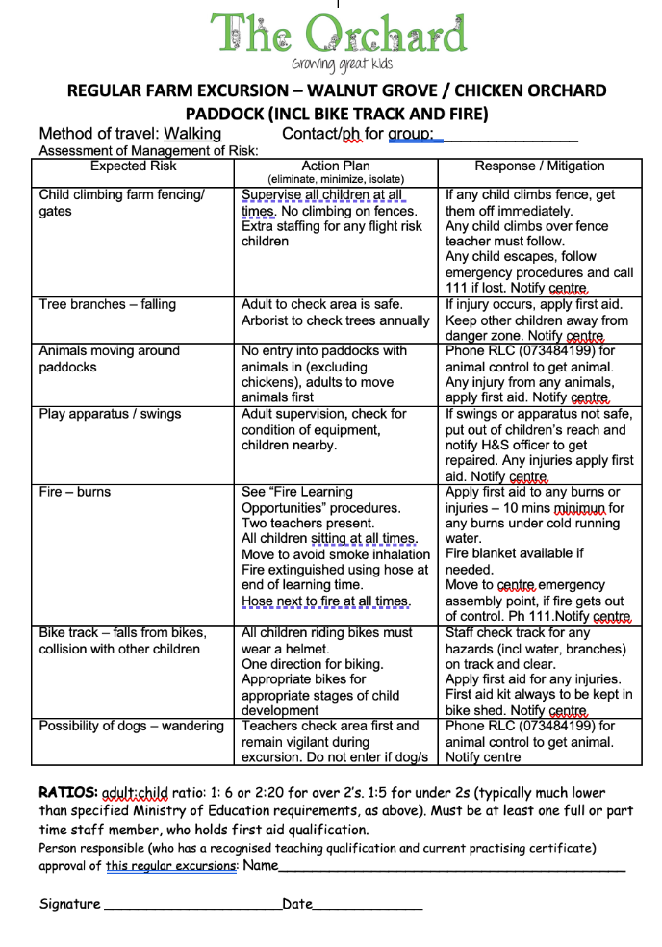
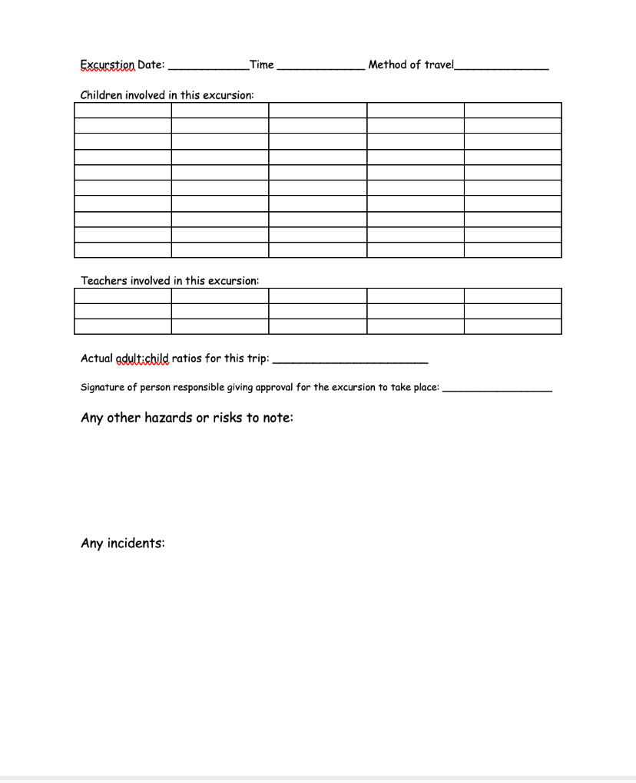

Slide 23
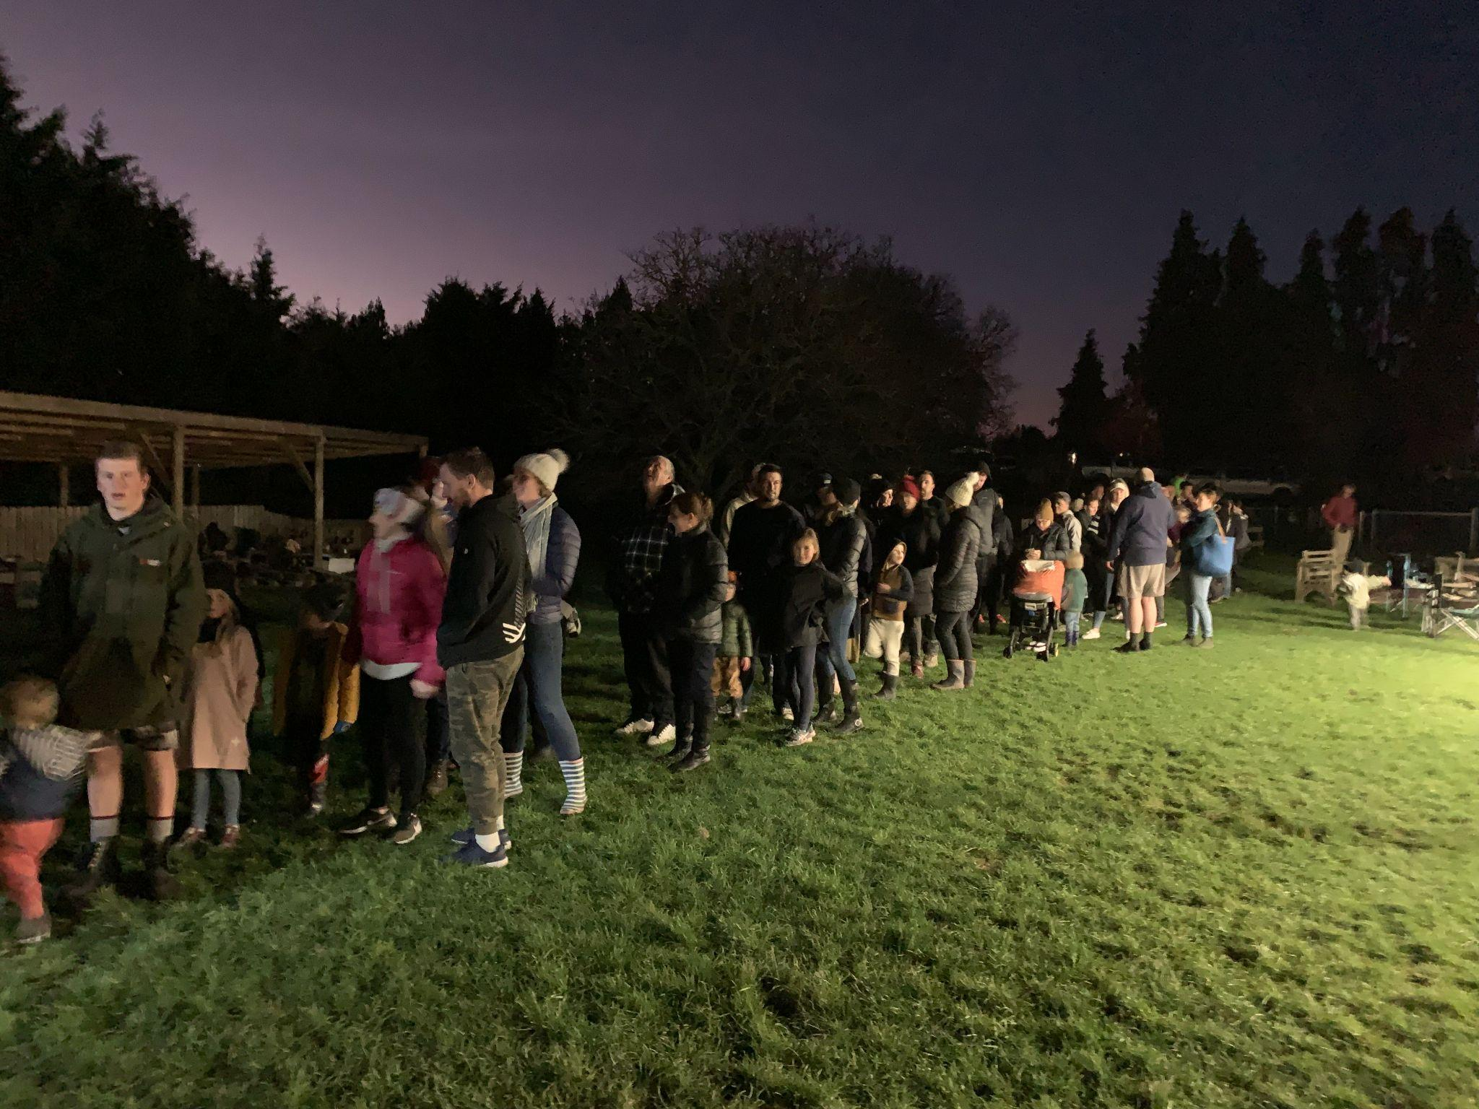
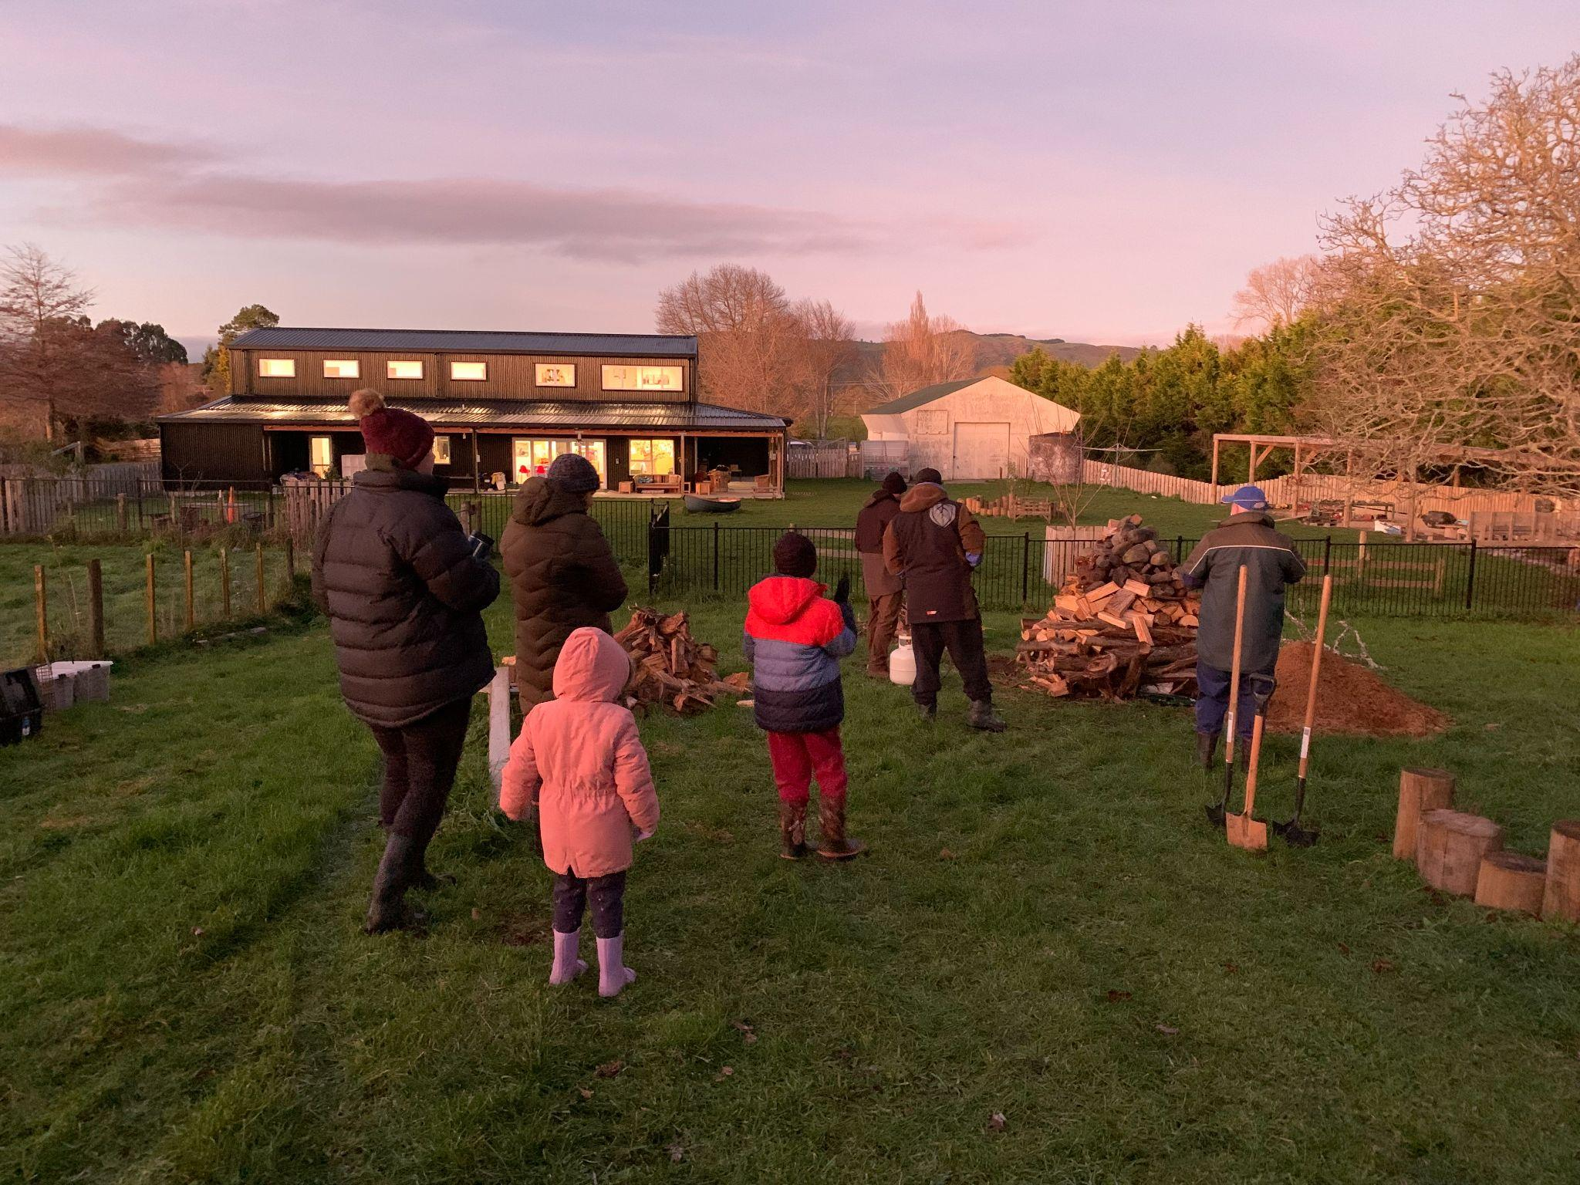
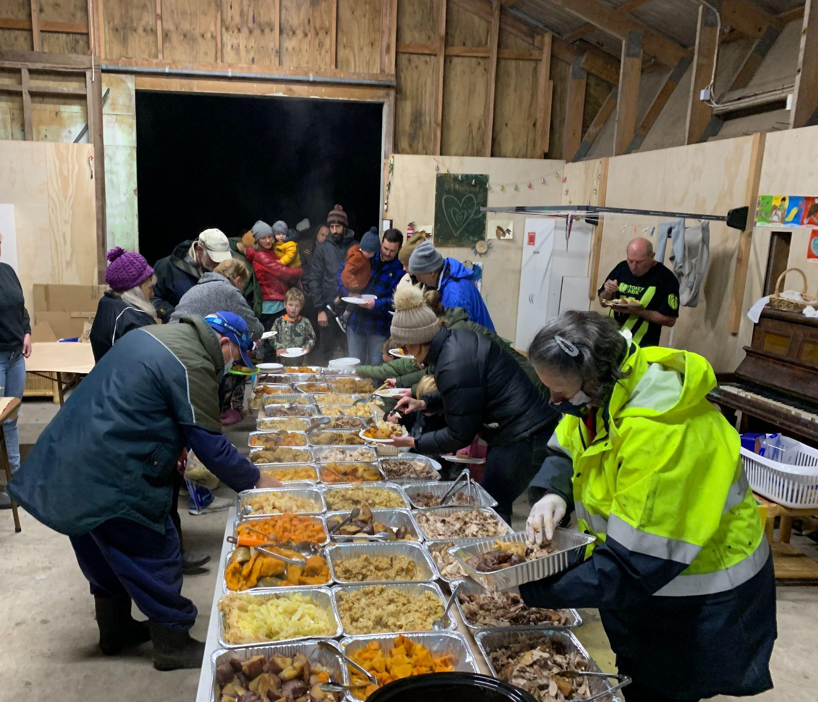

Slide 24
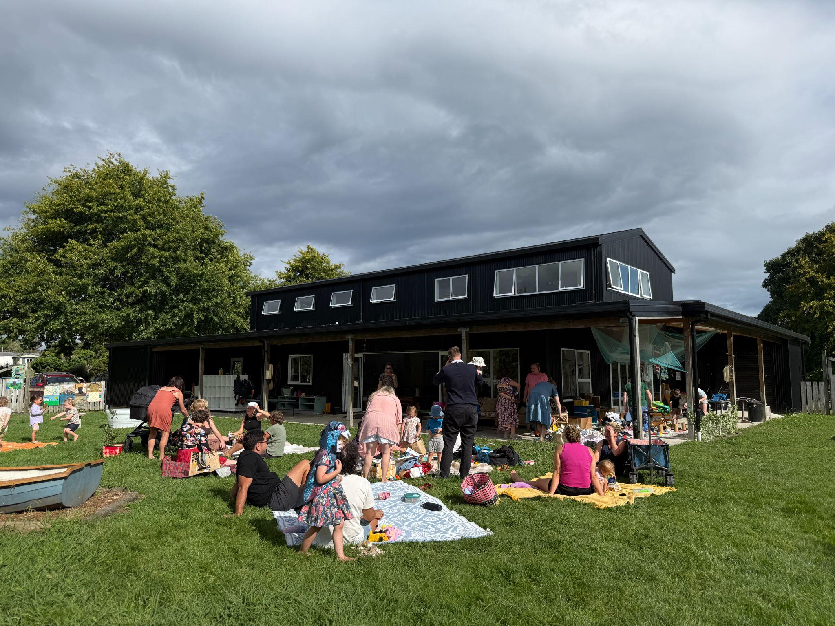

Slide 25
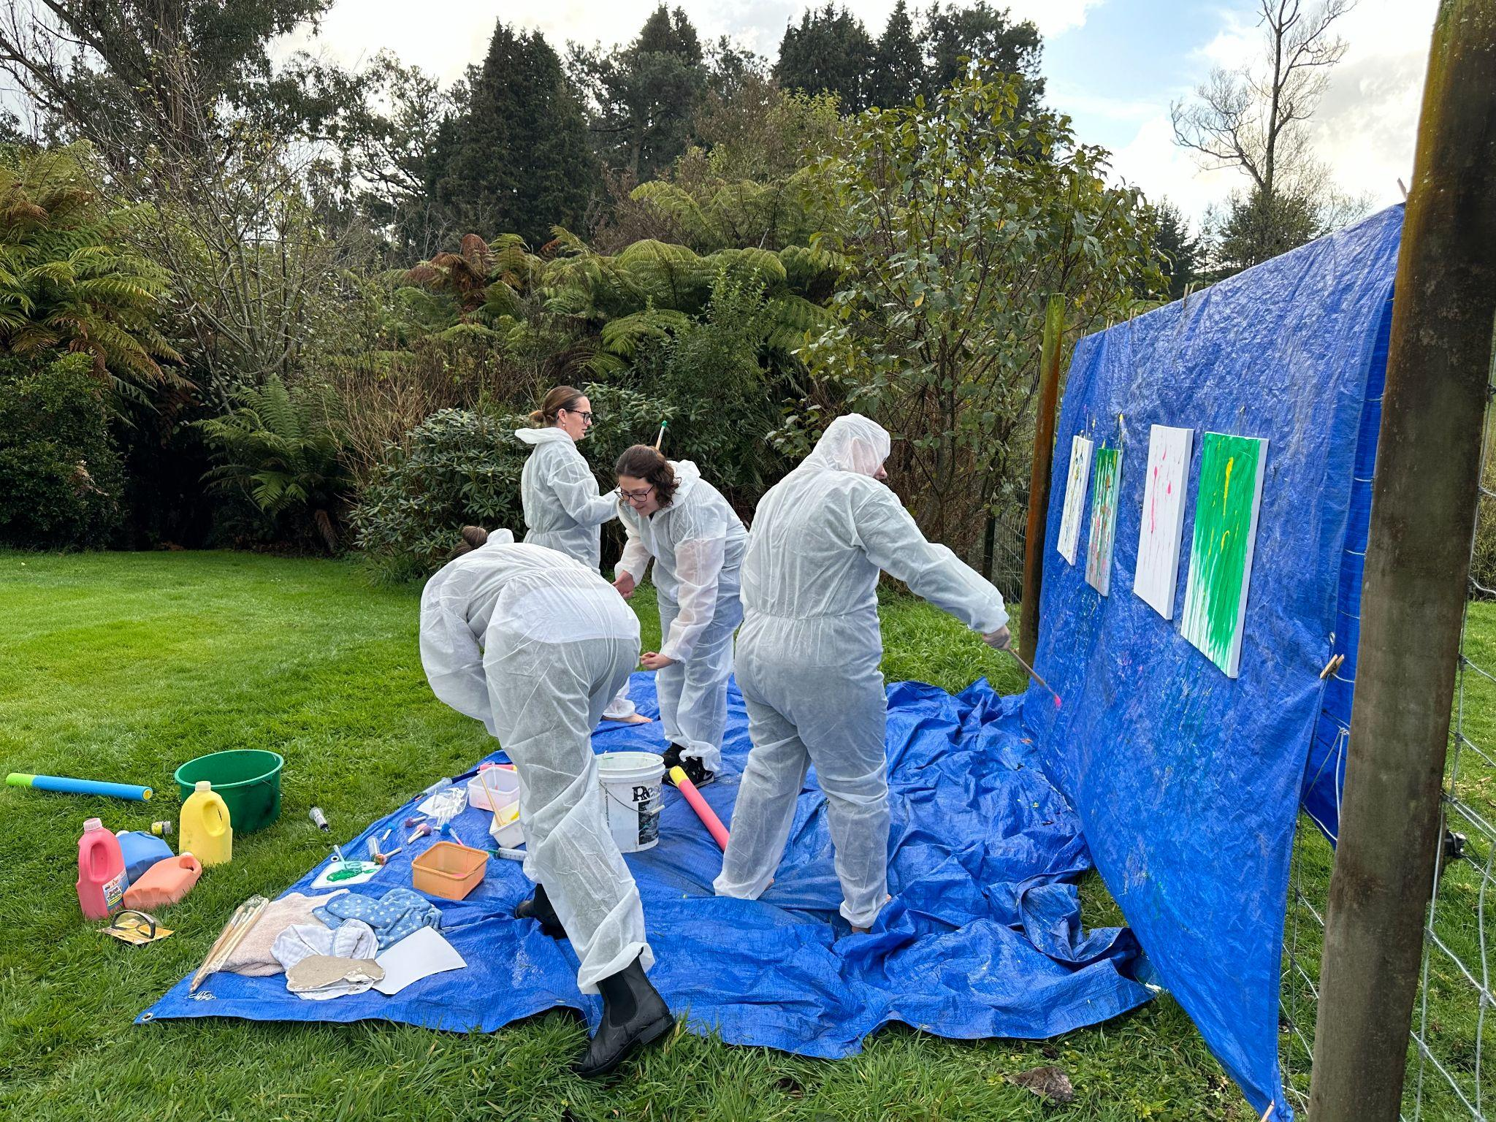
Community Engagement
Whanau evenings & events
Christmas play
Easter morning celebration
Matariki hangi meal
Pataka Kai
Mothers/ Father’s Day breakfasts
Clothing swaps
Meals for new babies arrival
Support local outreach Trinity Center w Kai n clothes
Disco evening
Retreats for Mums… fundraiser
Workshops for parents
Parenting podcasts
Pet day & Ag day visits
“Special” Community excursions
Book Hunting (like rock hunting but with literacy focus)

Slide 26
The Orchard Outside
Holiday programme - offset Full Pay Parity, 100% fully qualified staff.
Only open to Orchard graduates or siblings of children enrolled at The Orchard. Opportunity to reconnect with “our children”... We “know” them.
Staff members children (50% discount)
Not regulated by MoE. Based outdoors in our shed.
Teacher and helper
One out of Two weeks of school holidays… occasional Teacher Only Day.
Week at end of school year and one in January

Slide 27
Video removed for privacy

Slide 28
The Orchard Outside Overnight

Slide 29
Leading A Team - Keys to a low staff turnover… that work for me*
Long serving, amazing staff. Some 12/13 years, newest 3 years ago, retirees don’t retire.
Love them - patient, kind. Collaborative Leadership (all have different strengths)
Step up and In for them
Pay them what they deserve… 11/13 staff on Step 10 or 11 (2 on Step 7 & 8), big $$$$
Family always comes first
Go to the Cross Country, the swimming sports, the assemblies, school camps - they only get to be parents of littlies once, but educators for a lifetime
“Those parents” / “Those staff” - Look for the positives, show gratitude.
Always be things other people do that drive me nuts! Toilet rolls, photocopy paper, tissues, chicken food, pig nuts all out, Mrs Nobody broken things in the cupboard… BUT STOP, look at the BIG PICTURE! All the good things they do, the children they love and the willingness they do their job with, be grateful for them.
*DISCLAIMER - MAY NOT WORK FOR YOU

Slide 30
Team Culture
Throughout the year
Op shopping
Foraging
Meals out
Fun outings
Annually
Weekend away together, out of town.
Christmas FUNction

Slide 31
Q & A
www.theorchardchildcare.co.nz

